Slide 1
Generating Paintings with Generative Adversarial Networks
Scientific coordinator:
Prof. Dr. Păun Andrei
Graduate:
Dumitrescu Teodor

Slide 2
Contents
Overview of my work
Generative Adversarial Networks – Description
State of the art in human faces generation and painting generation
Data used for my project
Architecture used
My results
Web Application – Purpose
Future Work

Slide 3
Overview
Objective: generate paintings that resemble relevant historic art styles
Method: Generative Adversarial Networks
Tools: Python, PyTorch, Flask (for the web application)
State of the art: not a popular research direction, most works focus on random generation or generation based on content: abstract, landscape, portrait and not based on art style
Results: ability to generate 128 x 128 resolution paintings for 10 art styles
Showcase work: web application which allows users to generate paintings

Slide 4
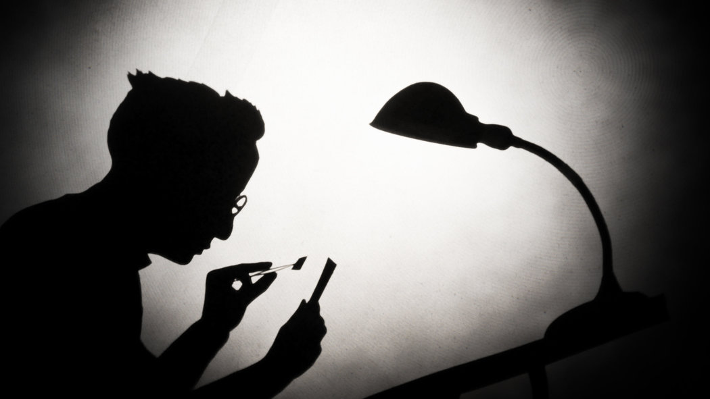

Generative Adversarial Networks
A system consisting of two networks: Generator and Discriminator
The Generator receives a vector of random numbers generated from a standard normal distribution and outputs an RGB image
The Discriminator receives either a real image or an image created by the Generator and outputs the probability of the image being real

Slide 5
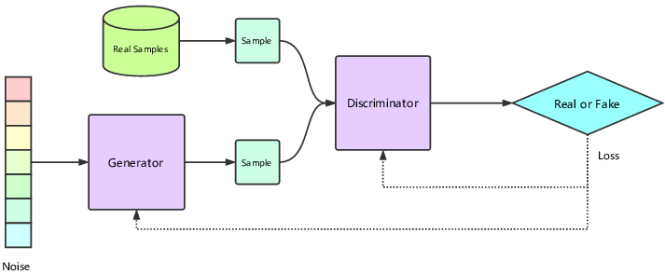
The Generator and Discriminator compete in a mini-max game
As any of the network gets better, the other one needs to keep up
A state of balance between the networks is desired
This balance is very hard to obtain in practice, training GANs is notably difficult

Slide 6
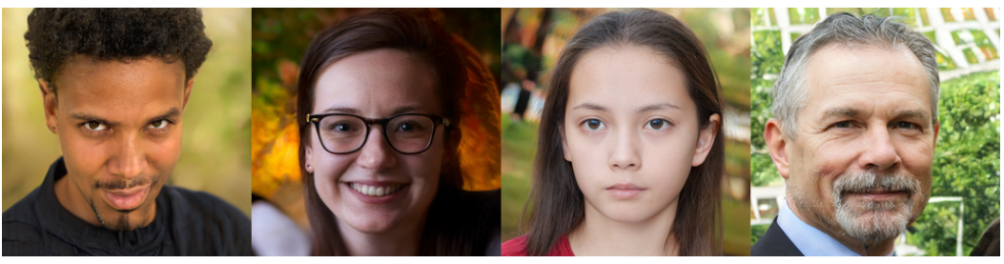
State of the art – human faces generation
Human faces generated with Nvidia’s StyleGAN2 in 2019
https://thispersondoesnotexist.com/

Slide 7
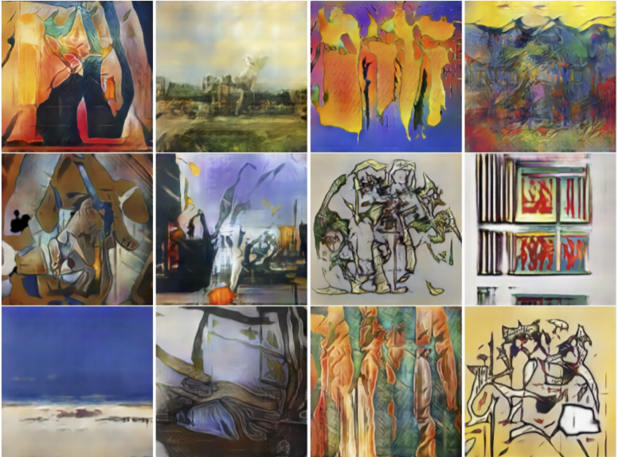
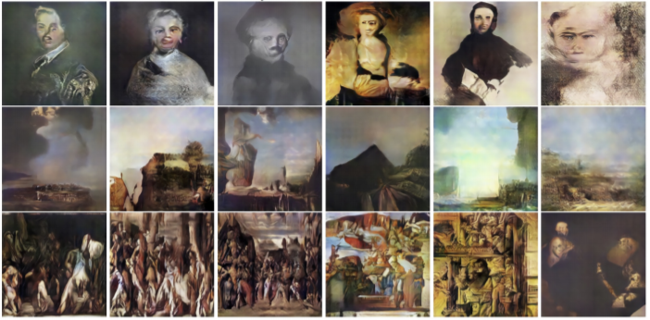
State of the art – painting generation
A. Elgammal, B. Liu, M. Elhoseiny, and M. Mazzone, “Can: Creative adversarial networks generating “art” by learning about styles and deviating from style norms,” in 8th International Conference on Computational Creativity, ICCC 2017. Georgia Institute of Technology, 2017.

Slide 8
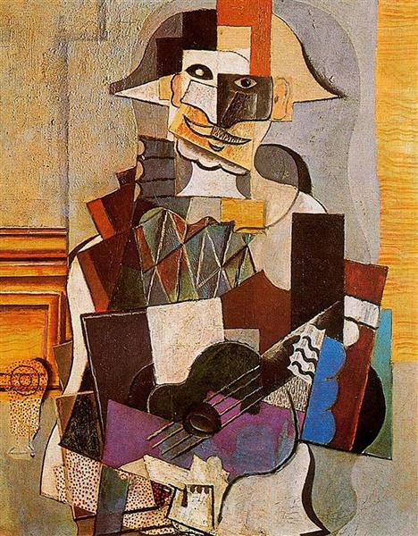
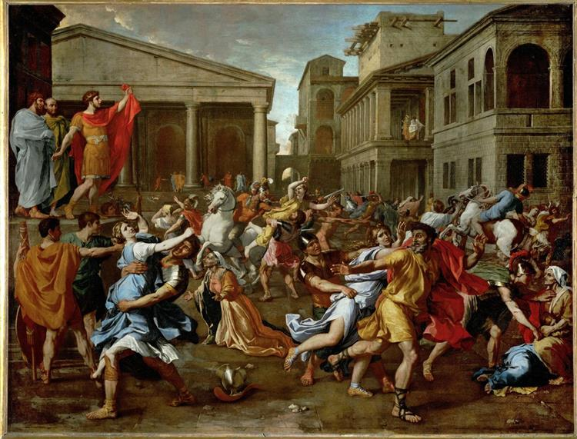

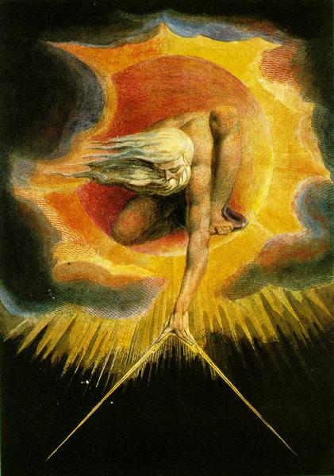
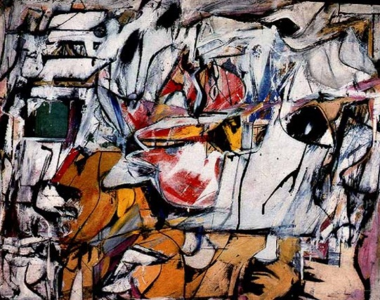
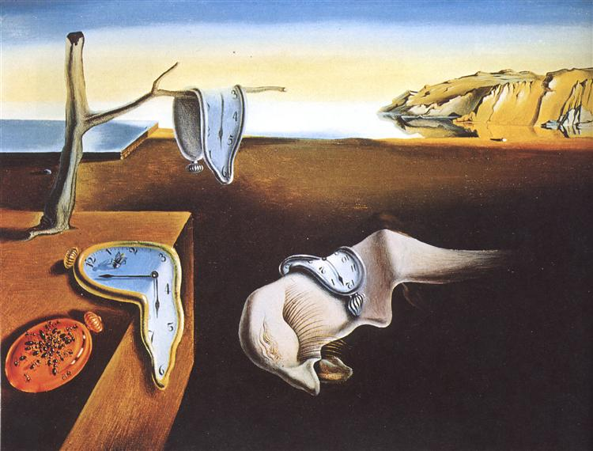
Data used for my work
Ten different art styles with 3,000 – 16,000 artworks each:
Abstract Expressionism
Baroque
Cubism
Expressionism
Impressionism
Post-Impressionism
Realism
Romanticism
Surrealism
Symbolism

Slide 9
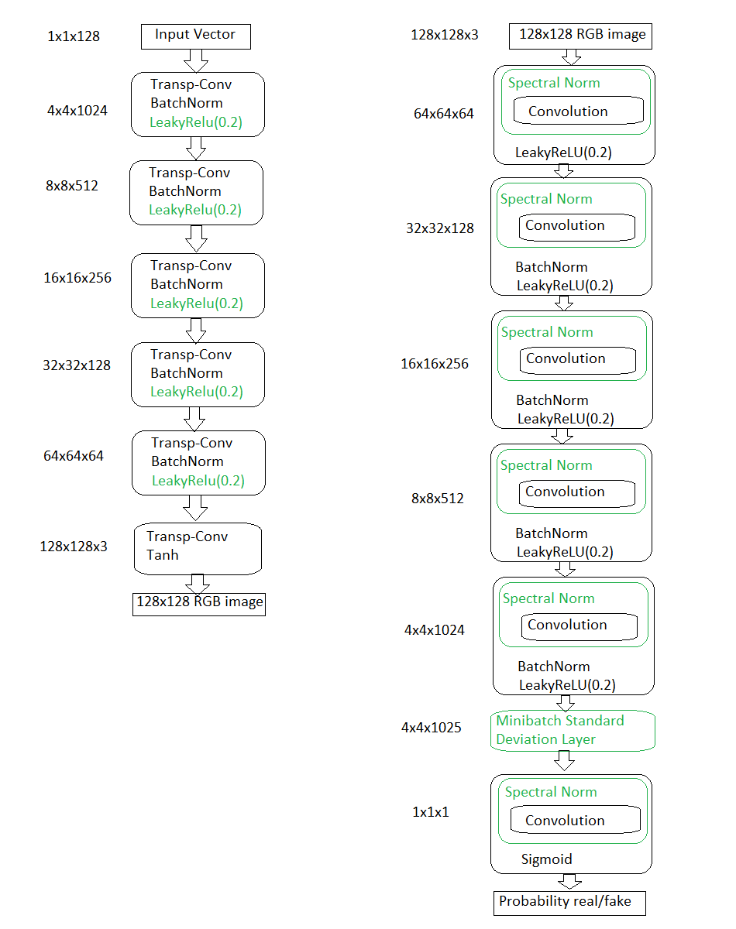
Generator
Discriminator
Architecture Used
The base architecture used is DCGAN (2015)
I added several techniques proposed in other GAN related papers in order to improve it and partially solve some of its problems.
Minibatch Standard Deviation Layer – Mode Collapse
Spectral Norm – Encourage convergence
LeakyReLU in the Generator – Vanishing Gradients
One-Sided Label Smoothing – Discriminator Overconfidence

Slide 10
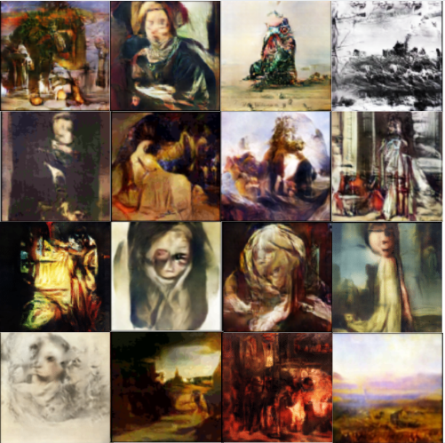
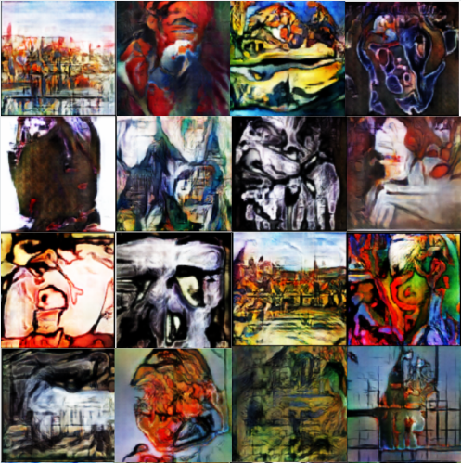
My Results – Romanticism and Expressionism

Slide 11
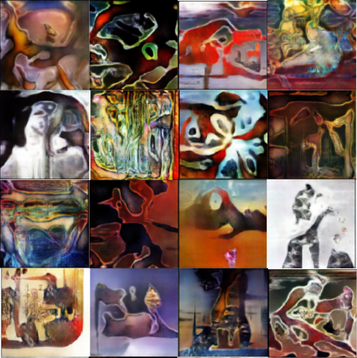
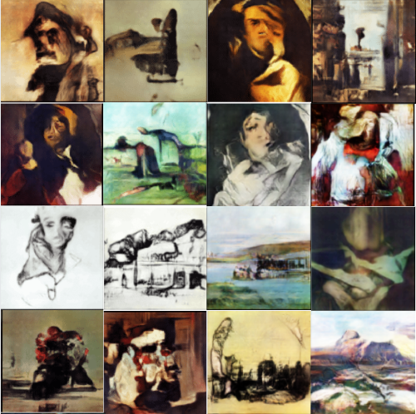
Paintings generated for one style are very different from the ones generated for other art styles
Images generated have some of the defining characteristics of their style
There is a lot of intra-style variety for each art style – even black and white paintings are generated
Surrealism
Realism

Slide 12
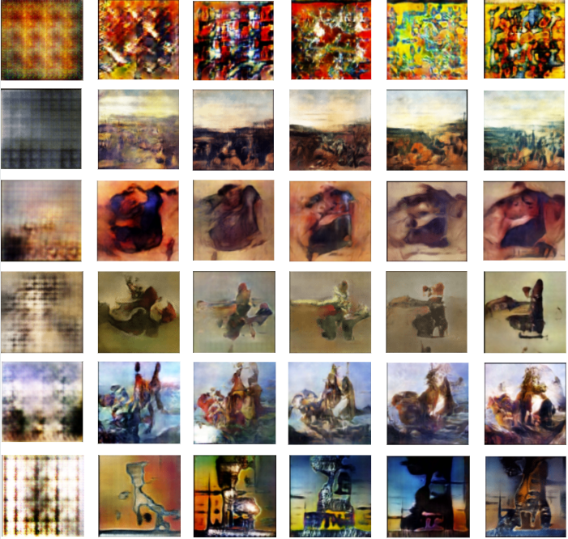
The evolution of a painting from 6 different styles, at the following epochs of training: 1, 20, 40, 60, 80 and 100.
The styles are in this order, from top to bottom:
Abstract Expressionism
Baroque
Impressionism
Realism
Romanticism
Surrealism

Slide 13
Web Application
Allow any user to generate 4 x 4 collages of paintings for any of the 10 art styles available
Showcase some of the best paintings I was able to generate
Try to show the beauty of art in an interactive way
Prove that one can create beautiful paintings with the help of Deep Learning, without being an artist himself

Slide 14
Future work
Deploy the web application in the cloud
Add more available art styles
Allow users to “reroll” paintings in their generated collage one by one
Maybe write a research paper

